Slide 1

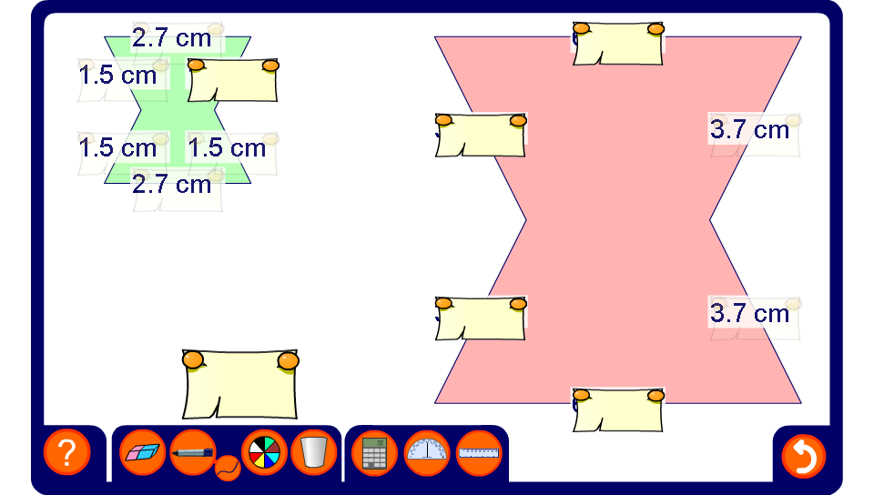


Finding lengths in two similar shapes
Notes:
Start by working out the scale factor for the enlargement. Use the scale factor to calculate the lengths of the missing sides before revealing them.

